Slide 1
Capstone Project: Stock Prices Analysis and Portfolio Management
Members:
Karteek Rao
Vamsidhar
Sumit Thakar

Slide 2
Objectives
Objectives:
Explore the stock prices based on trend, correlate between stocks.
Evaluate the stocks based on Capital Asset Pricing Model.
Suggest investment strategy for a client to achieve her financial goal of getting good but stable returns to fund her NGO.
Data:
Data of 12 stocks in the US market and the index SP500.
The stocks are from Aviation, Finance, Health Care, Technology.
Three stocks from each industry.

Slide 3
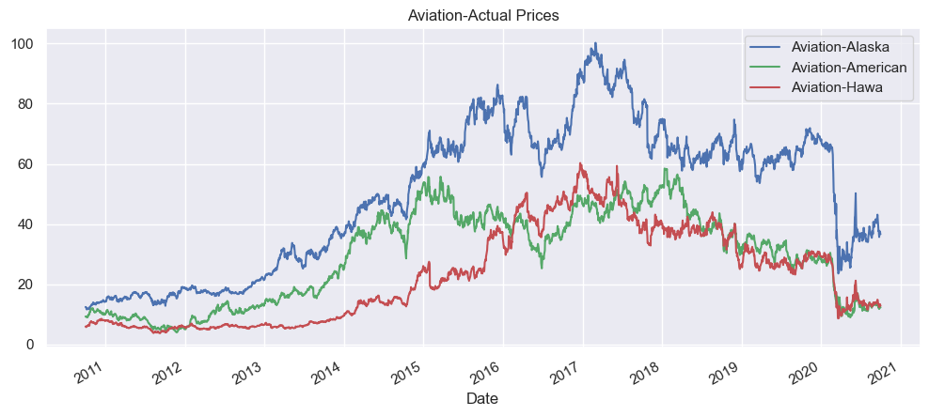
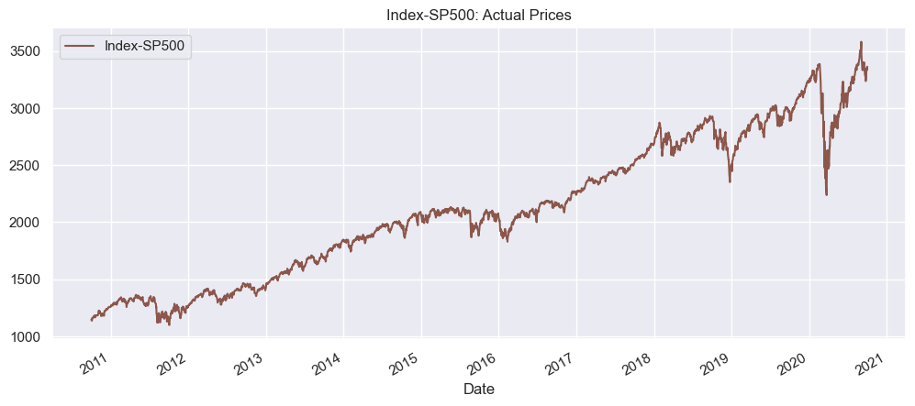
Trend-Actual Prices
Aviation Sector:
All 3 stocks in the aviation sector had an increasing trend until 2017-18
In march 2020, the steep fall in prices
The fail is attributed to the COVID outbreak.
The fall is steeper for Alaska Airlines
Post March, small positive trend in the prices of stocks
Significant variation in price level
The stocks sync with the SP500 index from March.

Slide 4
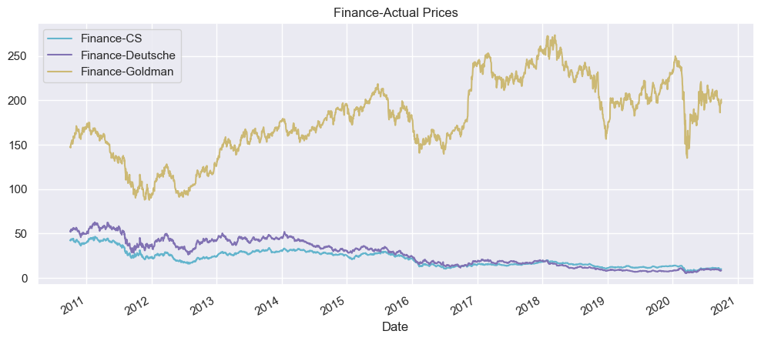
Finance Sector:
Significant Variation in price level between Goldman and other 2 stocks.
Credit Suisse and Deutsche Bank show a negative trend.
COVID-19 outbreak had a huge impact on Finance sector as we can see in March 2020.
There is a steep fall in prices.
After March, recovery of Goldman is intact and sync’s with index but hasn’t reached pre-covid levels.

Slide 5
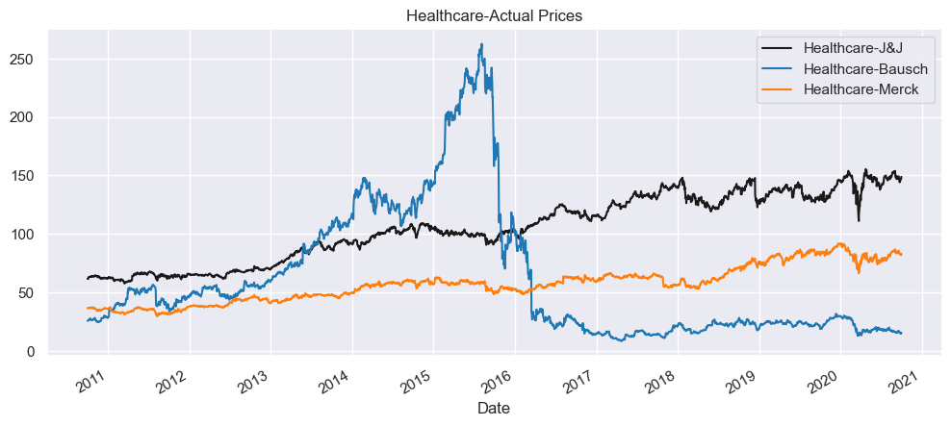
Health Care:
Bausch started low, reached its peak in mid 2015 and then there was a huge steep fall till 2016.
The Bausch incurred hefty charges due to inappropriate accounting.
Bausch had a huge debt burden which compounded the issue.
Johnson & Johnson and Merck grew steadily.
Johnson & Johnson was found to be one of the companies that recovered swiftly after COVID outbreak.

Slide 6
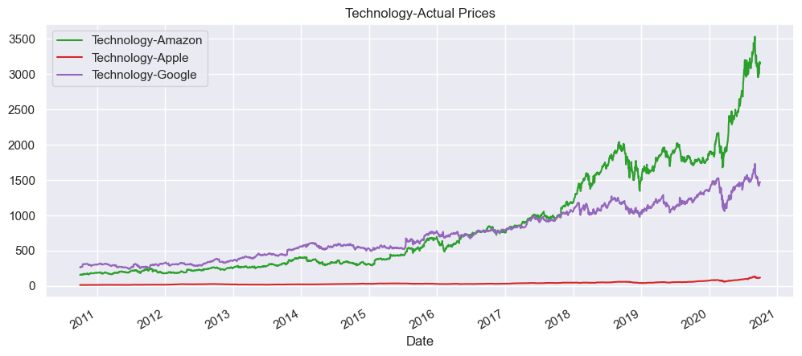
Technology Sector:
All 3 stock show a uptrend, Amazon being the highest.
The Growth of Amazon is phenomenal while Apple is progressing steadily.
Google was at the top in the beginning but from 2018 it fell below Amazon.
Price levels among these stocks vary widely. Apple’s prices are lowest.

Slide 7
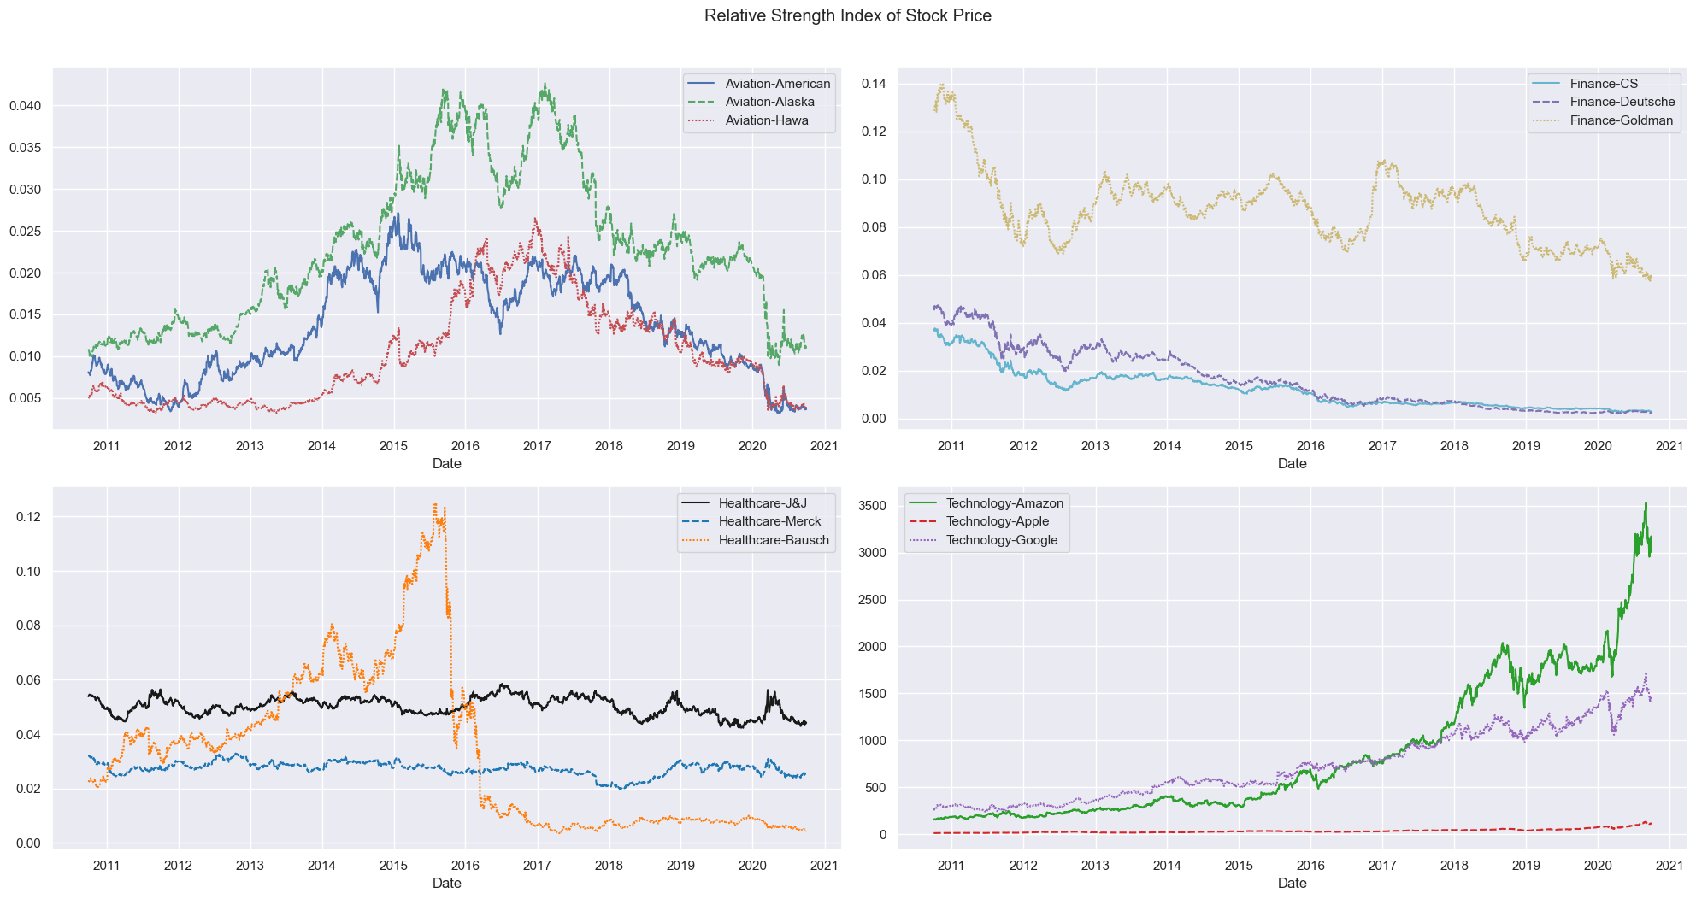
Relative Strength Index of Stocks

Slide 8
The relative strength index also confirms the earlier findings.
The only industry in uptrend is Technology
Price levels are entirely different
Health care, Johnson & Johnson and Merck move parallel with the index.
Stocks in Health Care and Finance industry show a downtrend comparatively.

Slide 9
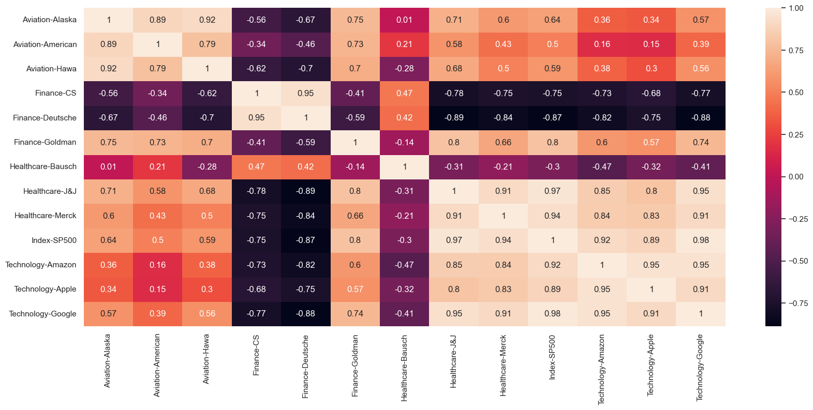
Correlation - Price

Slide 10
Stocks with strong and positive correlation(0.6 to 1):
Apple, Amazon, Google, Goldman Sachs, Johnson & Johnson, Merck & Co and Alaska.
Stocks with Weak Positive Correlation(0 to 0.6):
American Airlines, Hawaiian Holdings
Stocks with Negative Correlation(0 to -1):
Bausch Health, Credit Suisse, Deutsche Bank

Slide 11
CAPM Method Used For Selection of Stocks
Annualised Return
Cumulative Return
Annualised Ratio
Sharpe Ratio
Beta
Expected Return

Slide 12
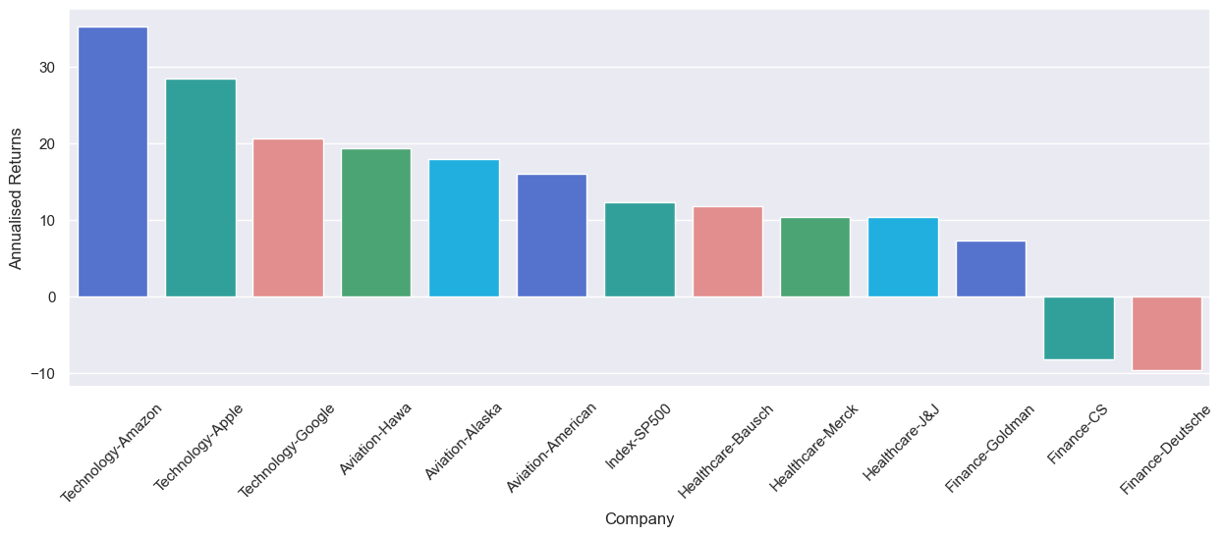
CAPM Annulaised Return

Slide 13
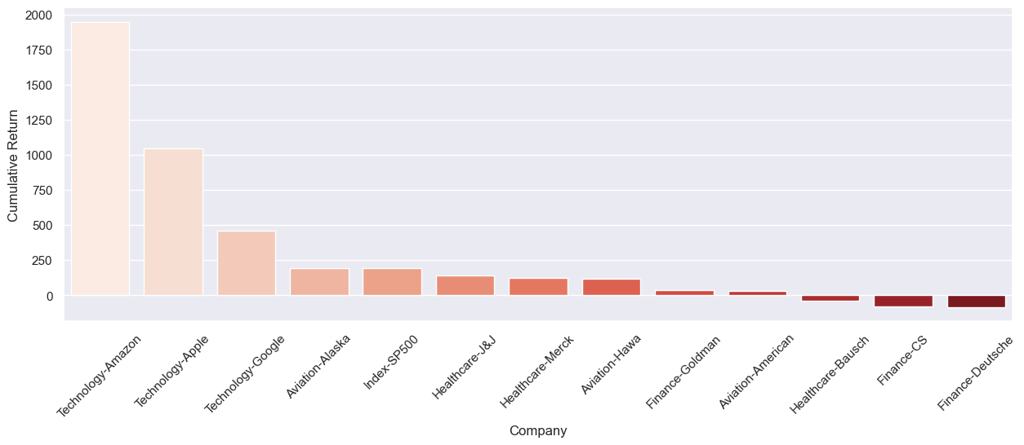
Credit Suisse and Deutsche Bank show negative annualized returns and cumulative returns and hence can be dropped.
Tech stocks stand at the top giving highest annualized and cumulative returns.

Slide 14
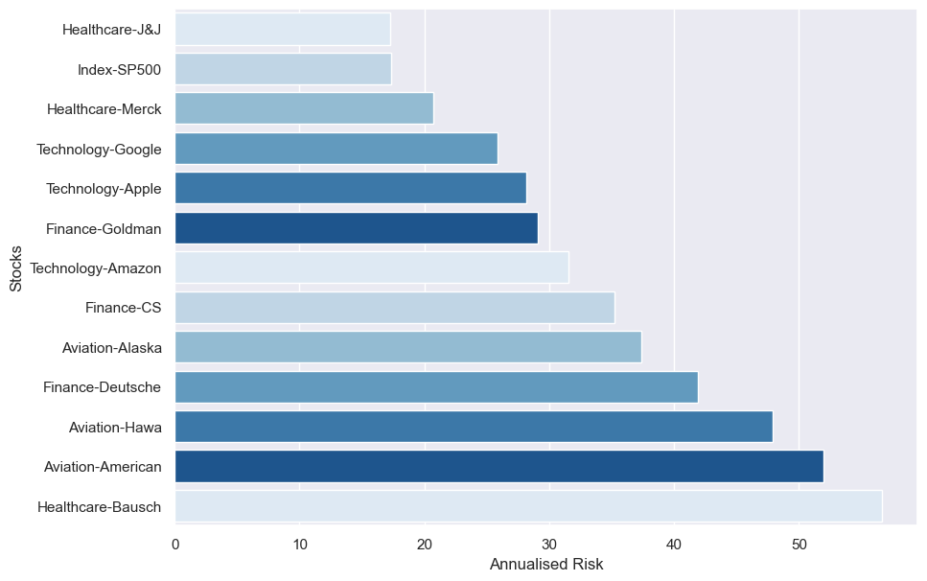
CAPM Annualised Risk & Sharpe Ratio

Slide 15
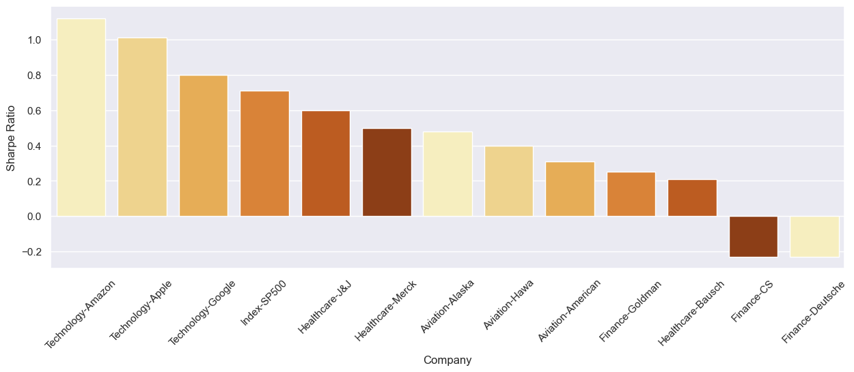
Sharpe Ratio is a composite index of risk and return. Higher the Sharpe ratio, the better the stock is.
Stocks with Sharpe Ratio more than that of index SP500 are Amazon, Apple and Google and others can be neglected.

Slide 16
CAPM Results
index | Annualised Returns | Cumulative Return | Annualised Risk | Sharpe Ratio | Beta | Expected Return
Aviation-Alaska | 17.87 | 194.28 | 37.4 | 0.48 | 1.231484452 | 14.96133057
Aviation-American | 16.03 | 32.29 | 51.95 | 0.31 | 1.353638806 | 16.37099183
Aviation-Hawa | 19.29 | 116.28 | 47.86 | 0.4 | 1.233664435 | 14.98648758
Finance-CS | -8.19 | -76.39 | 35.25 | -0.23 | 1.369945173 | 16.55916729
Finance-Deutsche | -9.62 | -84.03 | 41.87 | -0.23 | 1.537555516 | 18.49339065
Finance-Goldman | 7.32 | 36.07 | 29.1 | 0.25 | 1.301359034 | 15.76768325
Healthcare-Bausch | 11.71 | -39.65 | 56.67 | 0.21 | 1.315965338 | 15.93624
Healthcare-J&J | 10.3 | 141.1 | 17.22 | 0.6 | 0.662243082 | 8.392285167
Healthcare-Merck | 10.34 | 126.64 | 20.72 | 0.5 | 0.73347182 | 9.214264798
Index-SP500 | 12.29 | 193.39 | 17.36 | 0.71 | 1 | 12.29
Technology-Amazon | 35.22 | 1948.49 | 31.57 | 1.12 | 0.998854197 | 12.27677743
Technology-Apple | 28.4 | 1047.77 | 28.13 | 1.01 | 1.063316684 | 13.02067453
Technology-Google | 20.6 | 461.28 | 25.86 | 0.8 | 1.013406102 | 12.44470641

Slide 17
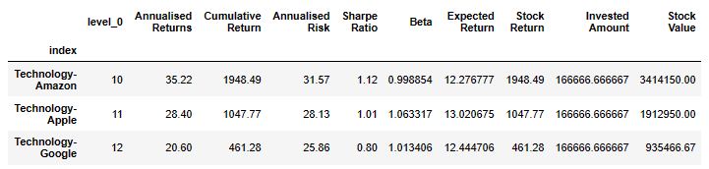
Results of Analysis of Recommended Stocks
Invested Fund (USD) : 500000
Investment Period: 10 years
Matured Amount: 6.2 Million USD
Annual ROI Portfolio: 29%
Annualised Risk: 28.52%

Slide 18
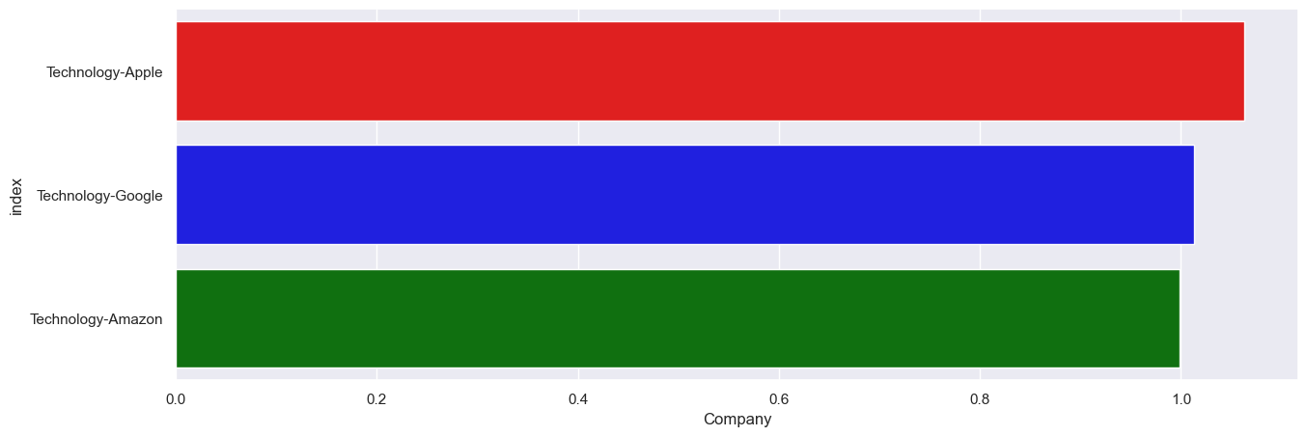
Recommended Stocks – Volatility & Expected Return

Slide 19
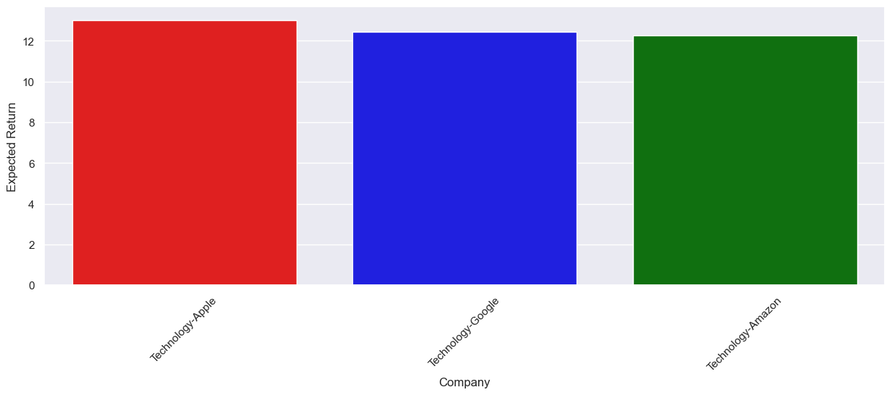
The volatility of all the tech stocks are not much alarming and are almost on par with the Index SP500.
All the tech stocks give an expected return which is more than or equal to that of index SP500.
As the stocks show a balanced volatility and expected returns, we can say that it can be selected for the portfolio.

Slide 20
Thank you

